Slide 1
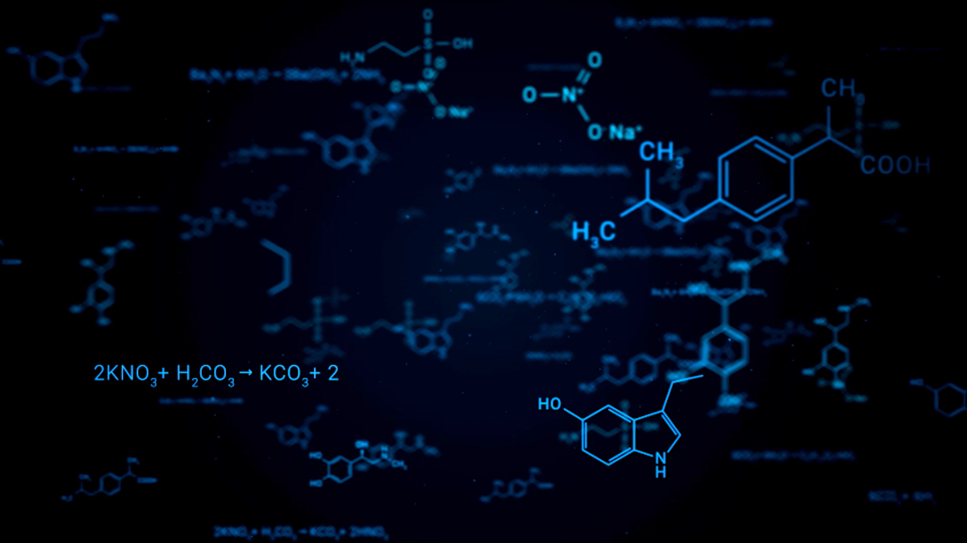
K-Means Clustering of Protein Consumption in Europe
Uncovering Dietary Patterns Across 25 European Countries

Slide 2

📊 Project Overview
Analyzed multivariate data from 25 European countries on daily protein intake from:
- Red meat, white meat, eggs, milk, fish
- Cereals, starch, nuts, fruits & vegetables
Goal: Use K-means clustering to discover dietary patterns and country groupings.

Slide 3

🛠️ Tools & Techniques
- Programming Language: R
- Libraries: ggplot2, factoextra, cluster, gridExtra
- Techniques: K-Means Clustering, Normalization, Dimensional Visualization

Slide 4
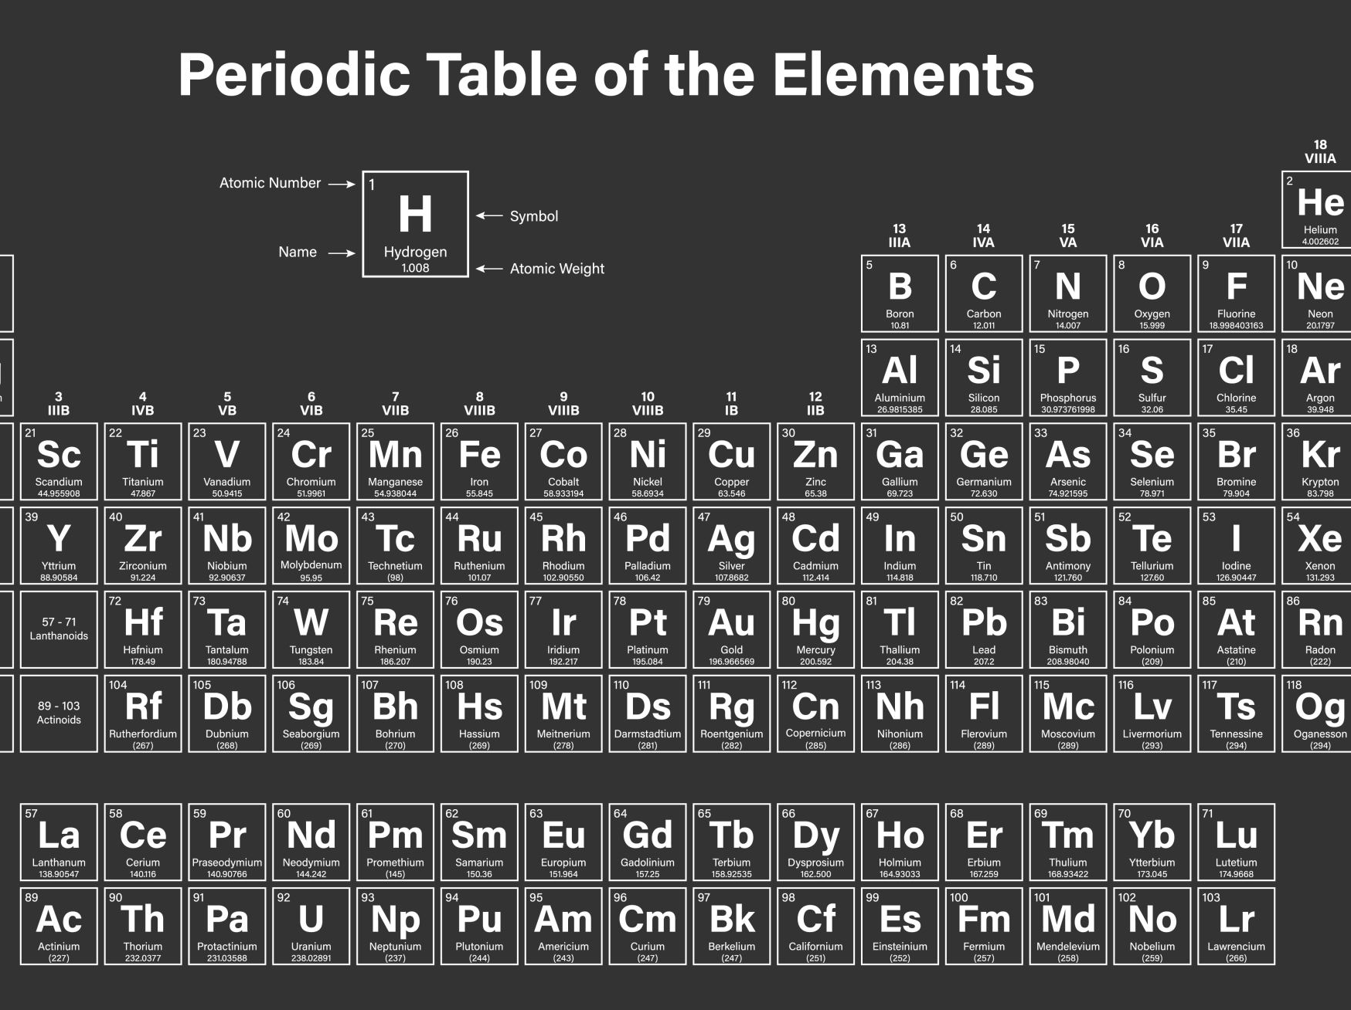
🧪 Methodology
🔹 Step 1: Clustering on RedMeat & WhiteMeat (k=3)
→ Western Europe: High red meat
→ Southern/Eastern: Moderate meat
→ Central/Northern: Balanced meat intake
🔹 Step 2: Full Clustering (k=7)
→ Included all 9 protein types (scaled)
→ Revealed complex diet clusters (fish, milk, starch, etc.)

Slide 5

💡 Key Insights
- Western Europe has high red meat and dairy consumption
- Southern/Eastern Europe leans toward plant/starch-based diets
- Central Europe shows dietary balance
- K-means effectively revealed clusters without supervision

Slide 6
🧠 Conclusion
K-means clustering enabled:
- Identifying regional dietary trends
- Supporting public health & market segmentation analysis
- Understanding real-world behavior through data
Unsupervised learning, made practical and powerful.

Slide 7

Thank you
Amandeep Randhawa
Data Analytics | Public Health | R Enthusiast

